Slide 1
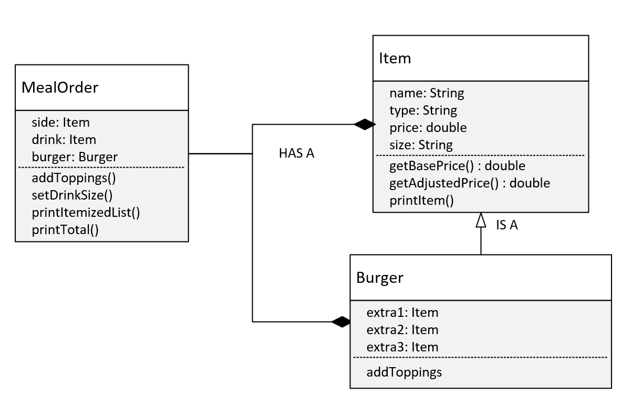

Bills Burger Challenge
I'll want to build out the Burger class, which we are saying, extends the Item class.
COMPLETE JAVA MASTERCLASS
OOP Master Challenge Exercise, Part 2

